Slide 1
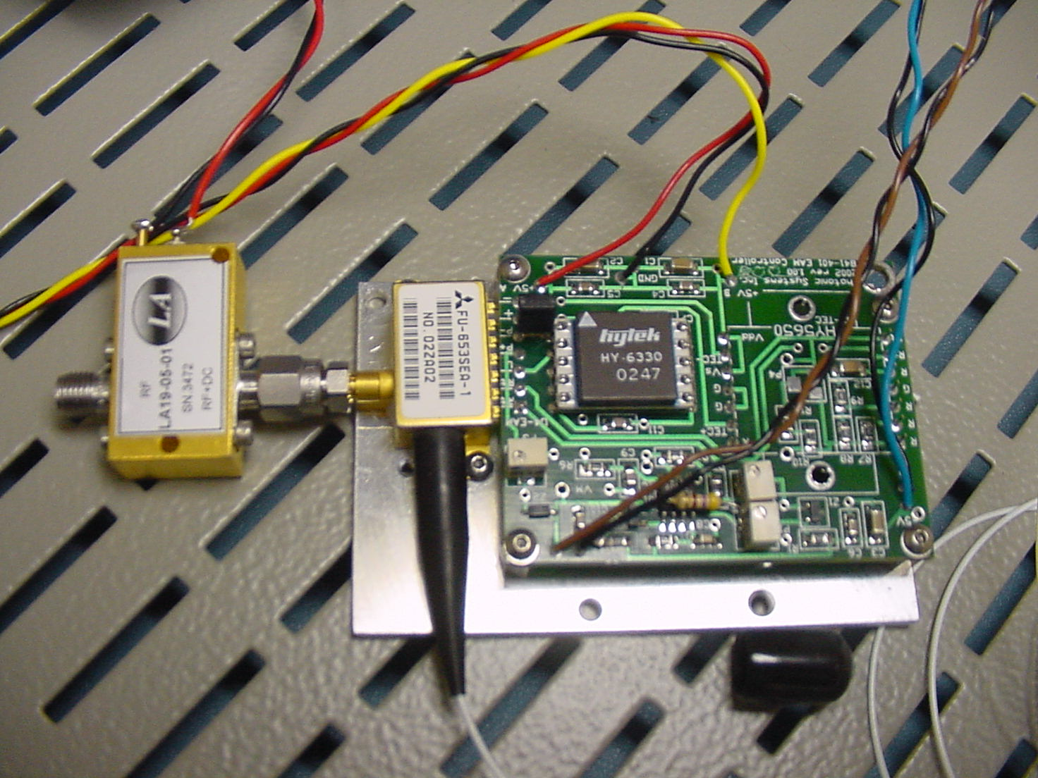
Testing of Mitsubishi FU653SEA Laser/Electroabsorption Modulator
Mitsubishi Laser/EAM
Device on OTX board
SMB connector
Bias tee for Vm
and RF signal to
modulator

Slide 2
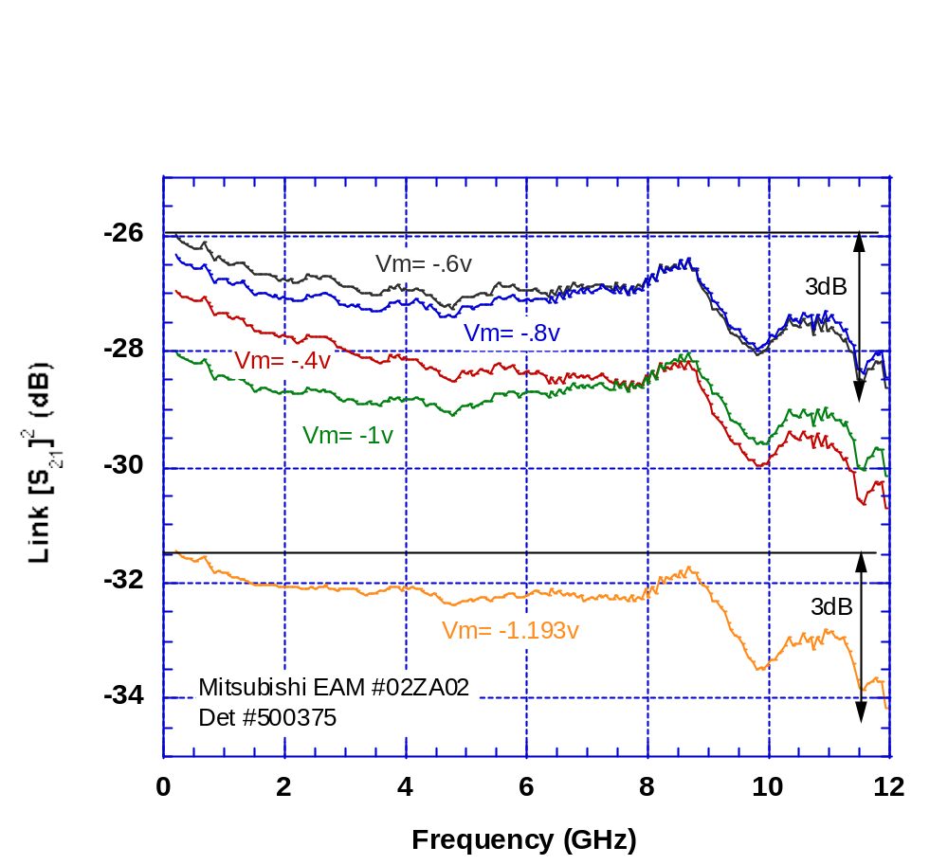
Mitsubishi FU653SEA Laser/EAM
Frequency Response vs. Bias

Slide 3
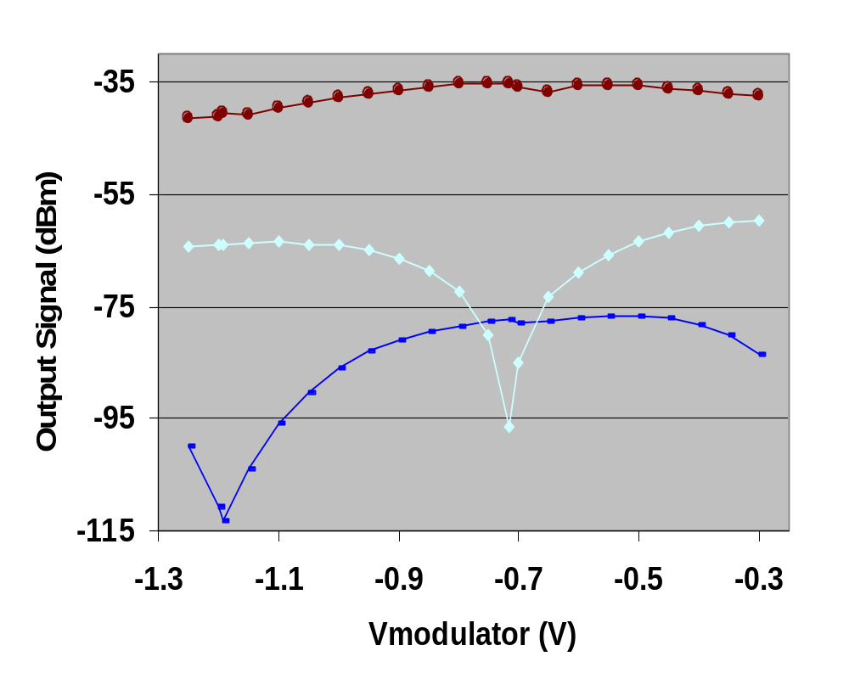
Mitsubishi FU653SEA Laser/EAM
Bias vs. RF Output
F1=5.055GHz F2=5.165GHz

Slide 4
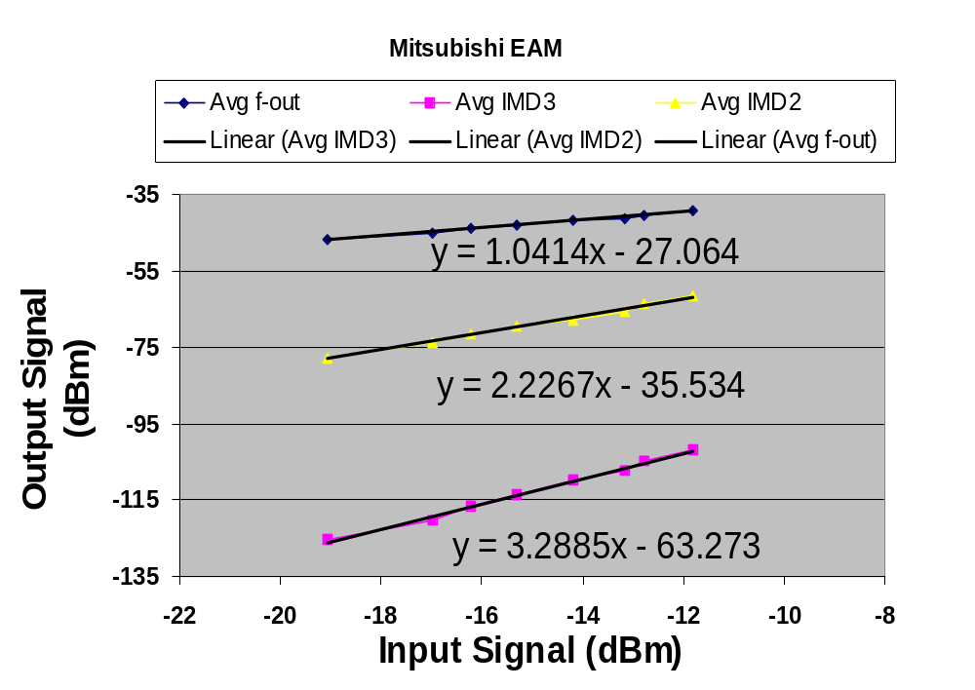
Mitsubishi FU653SEA Laser/EAM
Two-Tone IMD Performenec
F1=5.055GHz F2=5.165GHz Vm = -1.2v

Slide 5
Measured Performance* of Six Links
Link
1 (Fujitsu # 1M20329)
2 (Fujitsu # 18340)
3 (Fujitsu # 18341)
4 (Fujitsu # 18342)
5 (NEC # 128)
6 (Mitsubishi # 02ZA02)
G_{0.5 GHz}
(dB)
– 35
– 31
– 30.5
– 33
– 30
- 31.5
G_{11 GHz}
(dB)
– 38.5
– 32
– 32.5
– 35.5
– 32
- 33
NF *
(dB)
45
41
41
38.5
39.5
33.7
SFDR₃*
(dB·Hz^{2/3})
102
101
100
104.5
101.5
108.1
SFDR₂*
(dB·Hz^{1/2})
76
73
73
74
88
77
*
Performance is quoted at 5 GHz

